Slide 1
NLP Analysis of Yelp RevieWS
Israel Niezen, GA Data Science Student, Jan 2018

Slide 2
Project Description
Project Objective:
Leverage Natural Language Processing (NLP) and other advanced Data Science methods to determine if words included in YELP reviews can be used to classify and predict if the review will be positive or negative.
History/Context:
I became interested in NLP a few years ago, when working on a previous startup project.
NLP analysis of reviews can be utilized by businesses for a number of important use cases, including segmenting clients, reviewing competitors’ products, assessing market-demand, addressing client frustrations, identifying advocates, etc.
Data source: Kaggle Yelp Review Dataset:https://www.kaggle.com/c/yelp-recsys-2013

Slide 3
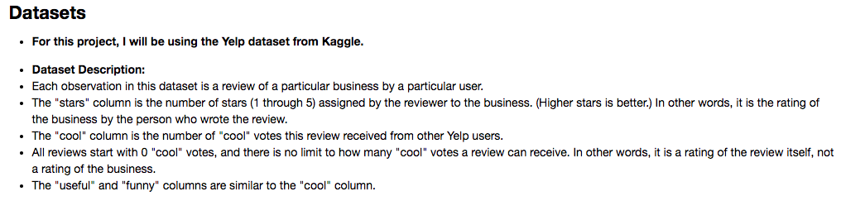
Libraries used and dataset description
Libraries imported: numpy, pandas, json, matplotlib, seaborn, scikitlearn, spacy, gensim LDA

Slide 4
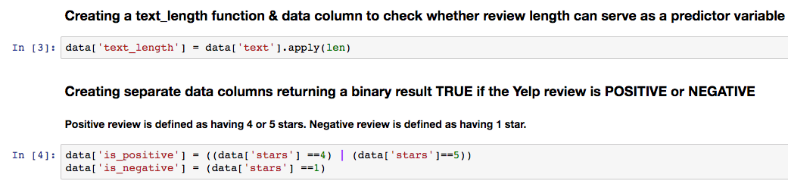
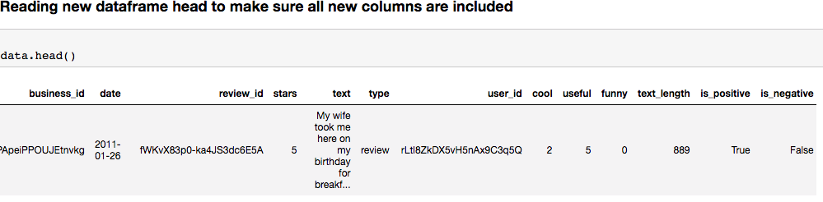
Augmenting dataset for further analysis
I added fields denoting the length of the review, and whether the review was positive or negative.

Slide 5
Exploratory data analysis
Very interesting preliminary findings

Slide 6
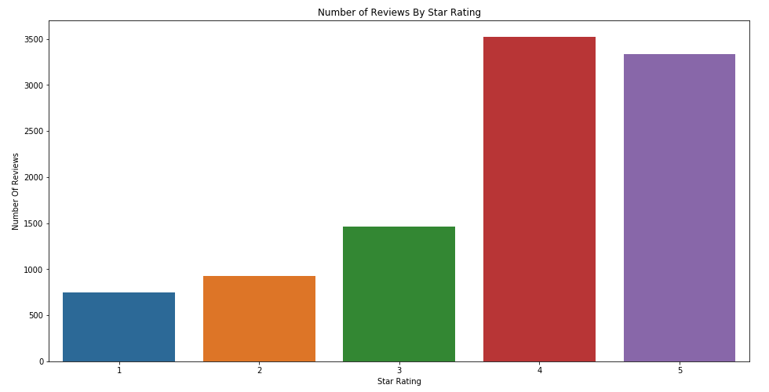
People prefer leaving positive reviews

Slide 7
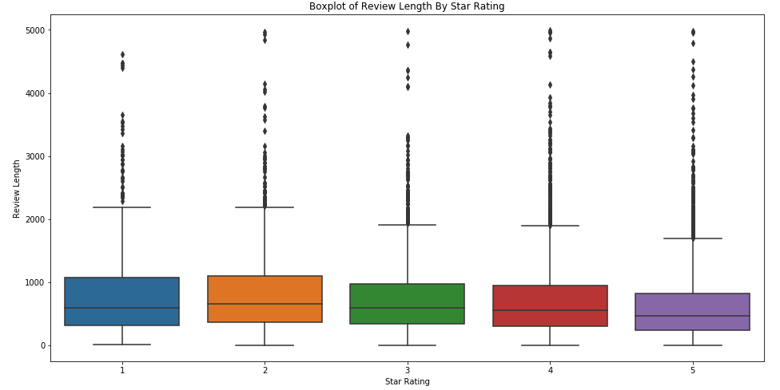
Negative reviews are longer than positive reviews

Slide 8
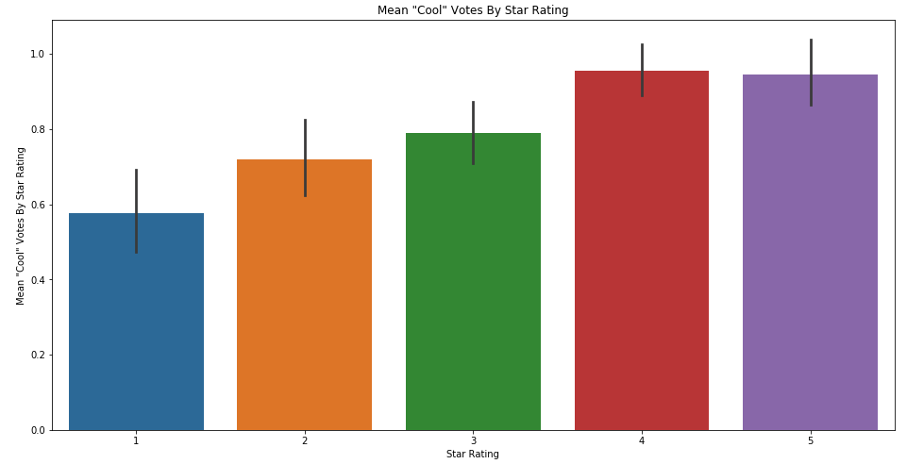
Positive reviews get more “cool” votes

Slide 9
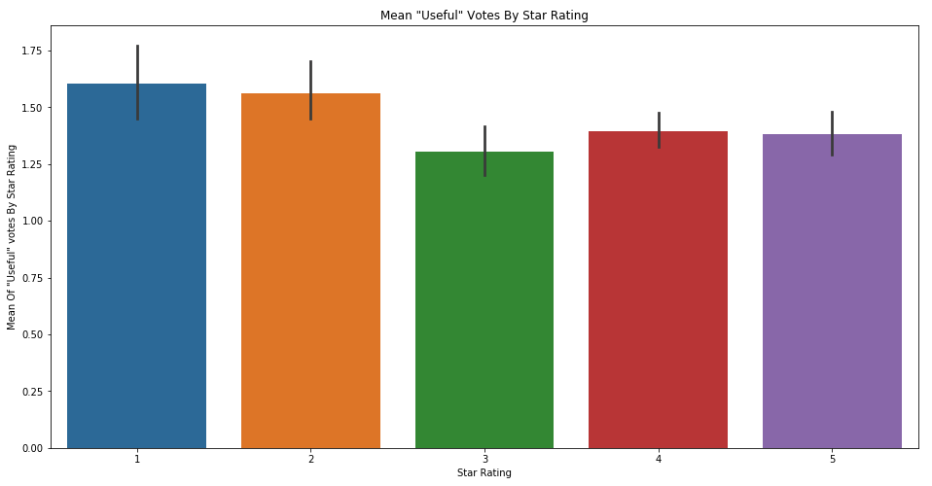
Negative reviews are most “useful” & less opinionated (3 star) reviews are least useful

Slide 10
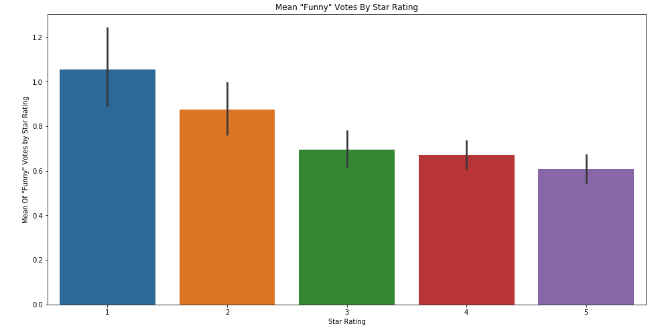
Negative reviews are funnier

Slide 11
NLP & Machine learning

Slide 12
Summary of methods and findings
Using multiple NLP algorithms and adding multiple layers of analysis, our project confirms that NLP analysis can be applied to Yelp reviews to accurately classify whether the review is positive or negative.
NLP Algorithms used: count vectorizer, random forest classifier, tf-idf vectorizer, LDA.
One can further improve the results of such analysis by layering in other variables like the length of the review.
To measure the accuracy and performance of our analysis and models, we utilized a commonly accepted “cross-validation” and “scoring” method for classification models called AUC (area under the curb), which is designed to provide a curve (called the ROC curve) that maximizes the correct classification of true positives (correct positive predictions) while minimizing false positives (incorrect positive predictions) at any given point.

Slide 13
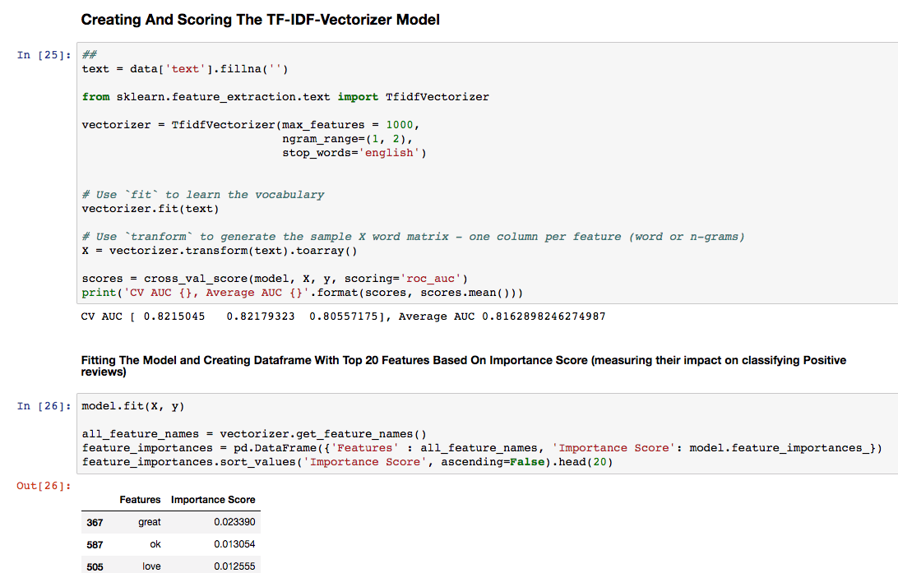
Code sample for the nerds among you

Slide 14
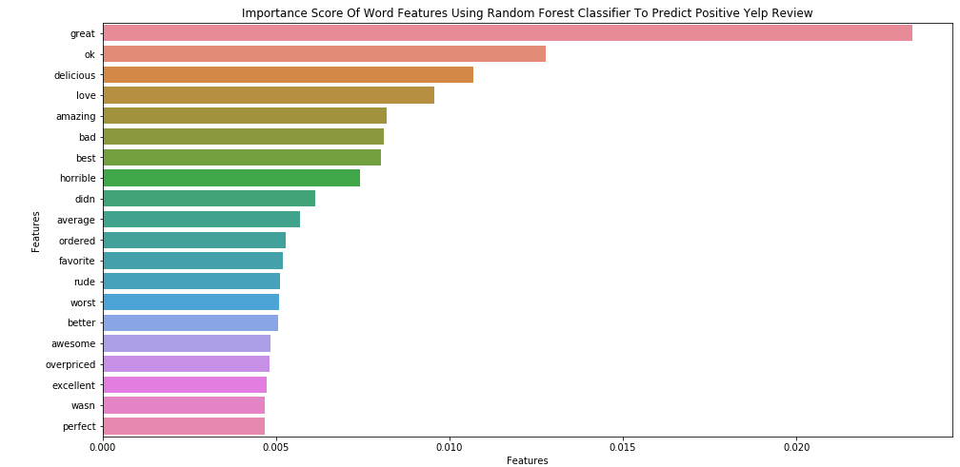
Random forest model accurately classifies Positive reviews using word features
CV AUC [ 0.80254783 0.81312029 0.80929071], Average AUC 0.8083196094354342

Slide 15
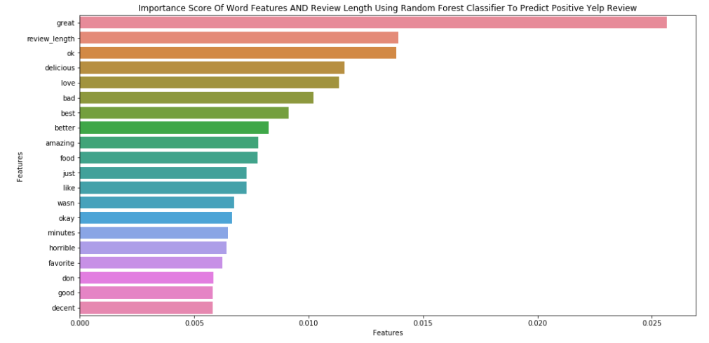
Random forest Model that includes review length and word features performs better
CV AUC [ 0.80925023 0.81400423 0.81677047], Average AUC 0.8133416450474508

Slide 16
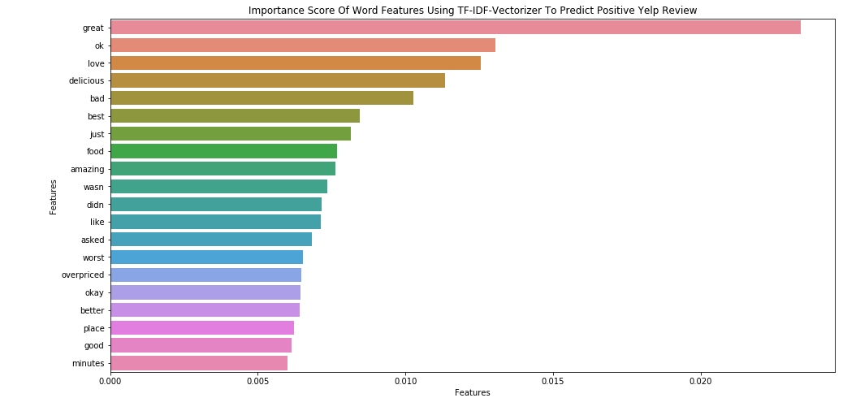
TF-IDF vectorizer classifies positive reviews even better than random forest
CV AUC [ 0.8215045 0.82179323 0.80557175], Average AUC 0.8162898246274987

Slide 17
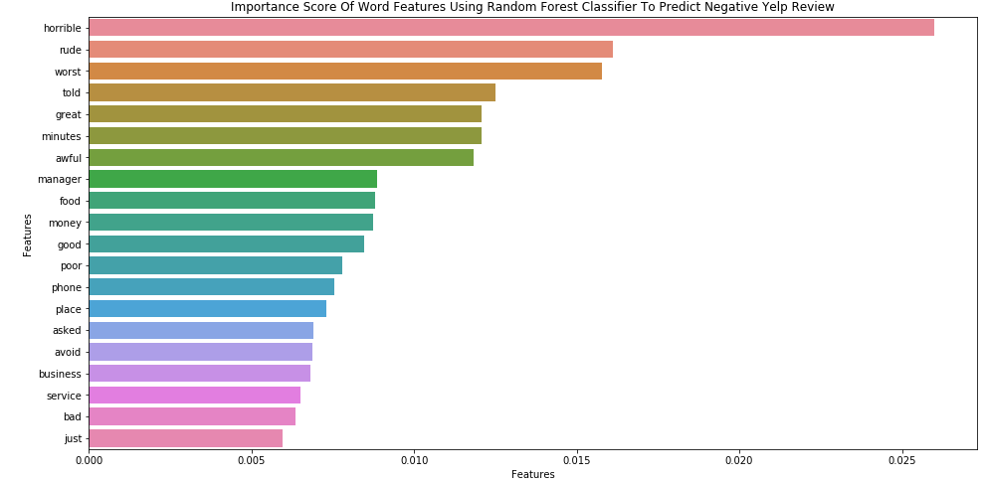
Random forest model also accurately classifies negative reviews using word features
CV AUC [ 0.80890208 0.83155966 0.81238675], Average AUC 0.817616163009585

Slide 18
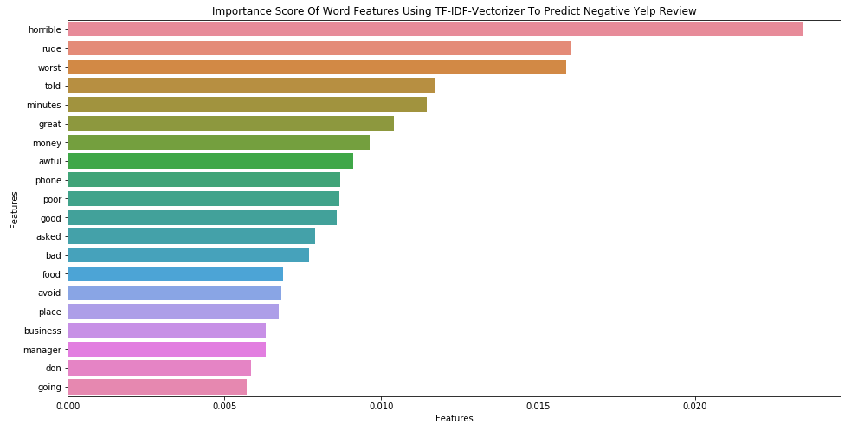
Tf-idf vectorizer on negative reviews does not offer improved accuracy
CV AUC [ 0.81040348 0.81934676 0.8162738 ], Average AUC 0.8153413465127971

Slide 19
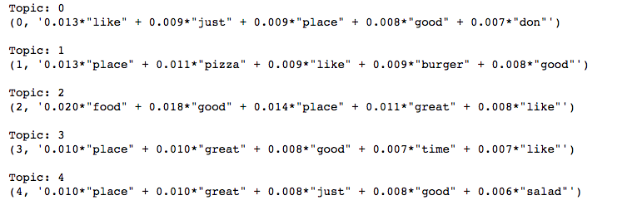
What didn’t work: Lda (latent dirichlet allocation) clustering
Also attempted to find useful clusters/topics, but did not get data that was too informative.

Slide 20
Next steps
In the future, I’d like to continue analyzing this dataset to see if I can do more around LDA and word clusters to try and classify themes and maybe types of businesses based on review text.
In addition to NLP, I’d like to see if there are other types of analysis that can be done like logistic regression, or others.
Additionally, would like to extend this learning to reviews on amazon, tripadvisor and other types of services I use to see if I can create a better score than they can to suit my definition of a positive review.

Slide 21
Acknowledgements and link to code
I’d like to thank Professor Naumaan Nayyar for his patience and support with the course and the project, including helping me debug certain things.
Below is the link to my code on Github if anyone would like to review it:
https://github.com/iniezen/GADataScienceProjects/blob/master/finalproject/Yelp_Project.ipynb

